Slide 1

Regularization for Reducing Overfitting V2
PhD. Msc. David C. Baldears S.
PhD.(s) Msc. Diego López Bernal
TC3007C
https://cnvrg.io/data-science-platform/dataset-management/

Slide 2
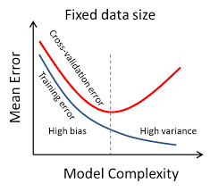
ANN Model Complexity
Remember: when adding more layers to the model (making it more complex) ? Adding more than required layers might also lead to overfitting.
By looking at the graph below can you guess, what should be an ideal model complexity?.

Slide 3
ANN Regularization
Too add regularization to a neural network
model.add(Dense(256,activation='relu', kernel_regularizer = 'l2'))
This adds the regularization L₂ to the current layer

Slide 4
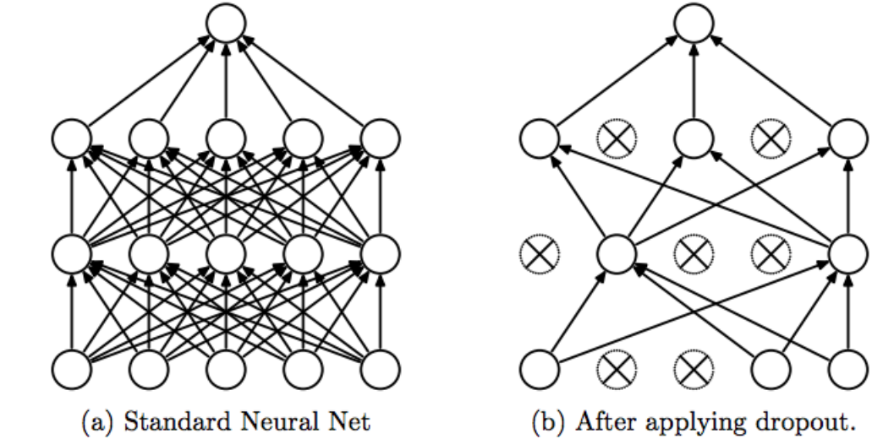
Dropout
Dropout is a regularization method that approximates training a large number of neural networks with different architectures in parallel.
It is preferably used when training a large neural network.

Slide 5
Dropping out
By dropping a unit out, it means temporarily removing it from the network, along with all its incoming and outgoing connections
Dropout has the effect of making the training process noisy, forcing nodes within a layer to probabilistically take on more or less responsibility for the inputs.
This conceptualization suggests that perhaps dropout breaks-up situations where network layers co-adapt to correct mistakes from prior layers, in turn making the model more robust.

Slide 6
Drop out Layers
It can be used with most types of layers, such as:
Dense fully connected layers
Convolutional layers
Recurrent layers such as the long short-term memory network layer.
Dropout may be implemented on any or all hidden layers in the network as well as the visible or input layer.
NOTE : It is not used on the output layer.

Slide 7
Why not just use early stopping rather than regularisation ?
The main downside of early stopping is that this couples two tasks:
Algorithm to optimize the cost function j (eg gradient descent, adam etc)
Prevent overfitting (ie get more data, regularization)
Because by stopping gradient descent early, we are sort of breaking whatever we are doing to optimize cost function J and simultaneously trying to not over fit.
Rather than using early stopping, one alternative is just use L2 regularization then we can just train the neural network as long as possible (the downside here is we have to try a lot of values of the regularization parameter lambda and hence it becomes computationally expensive)

Slide 8
Points to conclude with
Large weights in a neural network are a sign of a more complex network that has overfit the training data.
Probabilistically dropping out nodes in the network is a simple and effective regularization method.
A large network with more training and the use of a weight constraint are suggested when using dropout.
https://www.analyticsvidhya.com/blog/2018/04/fundamentals-deep-learning-regularization-techniques/

